Slide 1


Module 3. Lesson 1.
Basics of working
with files
Link to the methodological guidelines

Slide 2

Module 3. Lesson 1. Basics of working with files
Discussion:
Information
storage

Slide 3


Developers, new request!
The theoretical research institute has turned to us with a request for a Smart Notes application.
The scientists should be able to:
Create and delete notes.
Edit notes.
Add tags to notes.
Search the notes using tags.
Ready to get started?
Discussing
work tasks
Cole,
senior developer

Slide 4

Discussing the request
Before starting work on the request, we need to answer the following questions:
How do we organize the storage of these notes?
How do we program the appearance of the program?
Discussing
work tasks

Slide 5
Let's recall how we worked with data in Memory Card
The user runs the program.
The user enters questions and answers.
The user practices on the entered data.
The user closes the program.
But the entered data was not saved!
Discussion:
Information storage

Slide 6
How will the scientists work with the Smart Notes app?
A brilliant idea comes to mind
The physicist creates a note with that idea
After work the physicist goes off to sleep
The physicist wakes up and goes to work
Discussion:
Information storage
They open the Notes application and add the idea to it
During that time, they
close the Notes application
The physicist reopens Notes and wants to continue working

Slide 7
Discussing the request
Before starting work on the request, we need to answer the following questions:
How do we organize the storage of these notes?
We need to program long-term storage of information! For example, we can use text files.
How do we program the appearance of the program?
Of course, using PyQT!
Discussing
work tasks

Slide 8
The goal of the work day is
to explore means of interaction between the program and text files for long-term data storage.
Today you will
Discussing
work tasks
Understand the need to use text files.
Learn the various attributes for accessing a text file.
Program your own system of program data storage in a text file.

Slide 9

Module 3. Lesson 1. Basics of working with files
Brainstorming:
Basics of working
with text files

Slide 10
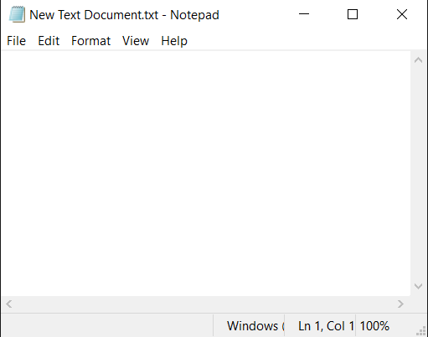
Let’s look at storing data in a text file
The text file format | .txt
A standard program for working with .txt | Notepad, Text Editor, etc.
Brainstorming

Slide 11
Let’s look at storing data in a text file
The text file format | .txt
A standard program for working with .txt | Notepad, Text Editor, etc.
Brainstorming
How does a program access such a file to save data?

Slide 12
Interaction between the program and text file
The program wants to save data in a file
Brainstorming

Slide 13
Interaction between the program and text file
The program creates a .txt file in the project folder
The program wants to save data in a file
The program records data in the file
Brainstorming
The program saves and closes the file

Slide 14
Interaction between the program and text file
The program creates a .txt file in the project folder
The program wants to save data in a file
The program records data in the file
Brainstorming
Python has special functions for opening, reading, and writing data, and closing the file.
The program saves and closes the file

Slide 15
Accessing the data file
The “Notes.txt” file
Open the file to read data
Open the file to record data
Open the file
to append
Brainstorming
The program only sees the data, but it cannot make changes to it (the file cannot be corrupted)
The program can write new data in the file (the old contents are deleted!)
The program can write data in the file by adding new strings after existing ones

Slide 16
File access parameters
Using different access attributes, you can open files for specific purposes.
Function purpose | Function in Python
Open file for reading | open(“notes.txt”, “r”)
Open file for recording (old content is deleted!) | open(“notes.txt”, “w”)
Open file for appending (information is added at the end of the file) | open(“notes.txt”, “a”)
Brainstorming

Slide 17
Reading data from a file using the with operator
The file must be in the same folder as the program!
Function purpose | Function in Python
Opening a file for reading | with open(“notes.txt”, “r”) as file:
Reading file data | data = file.read()
Reading file data (result is a rowset) | lines = file.readlines()
Close file when finished | The file closes automatically after the end of the with block
Brainstorming

Slide 18
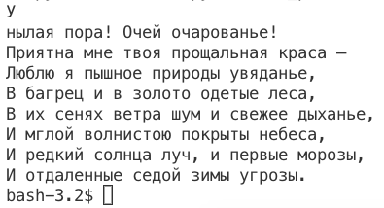
Example: reading data
files_program.py
Outcome
with open(
"poem.txt", "r", encoding = "utf-8"
) as file:
data = file.read(1)
print(data)
data = file.read()
print(data)
If I can stop one heart from breaking,
I shall not live in vain;
If I can ease one life the aching,
Or cool one pain,
Or help one fainting robin
Unto his nest again,
I shall not live in vain.
Brainstorming

Slide 19
Example: reading data
files_program.py
Outcome
with open(
"poem.txt", "r", encoding = "utf-8"
) as file:
data = file.read(1)
print(data)
data = file.read()
print(data)
If I can stop one heart from breaking,
I shall not live in vain;
If I can ease one life the aching,
Or cool one pain,
Or help one fainting robin
Unto his nest again,
I shall not live in vain.
Brainstorming
The first character was read and printed separately. The rest were read together after it.

Slide 20
Functions for recording data in a file
The file must be in the same folder as the program!
Function purpose | Function in Python
Opening (creating) a file for recording | with open(“notes.txt”, “w”) as file:
Recording data in the file | file.write(“Information”)
Closing the file | The file closes automatically after the with operator block ends
Brainstorming

Slide 21
Example: recording data
files_program.py
poem.txt
#add the author of the poem
with open(
"poem.txt", "w", encoding = "utf-8") as file:
file.write("\nE. Dickinson")
with open(
"poem.txt", "r", encoding = "utf-8"
) as file:
data = file.read()
print(data)
If I can stop one heart from breaking,
I shall not live in vain;
If I can ease one life the aching,
Or cool one pain,
Or help one fainting robin
Unto his nest again,
I shall not live in vain.
Brainstorming

Slide 22
Example: recording data
files_program.py
poem.txt
#add the author of the poem
with open(
"poem.txt", "w", encoding = "utf-8"
) as file:
file.write("\nE. Dickinson")
with open(
"poem.txt", "r", encoding = "utf-8"
) as file:
data = file.read()
print(data)
E. Dickinson
Brainstorming

Slide 23
Example: recording data
files_program.py
poem.txt
#add the author of the poem
with open(
"poem.txt", "w", encoding = "utf-8"
) as file:
file.write("\nE. Dickinson")
with open(
"poem.txt", "r", encoding = "utf-8"
) as file:
data = file.read()
print(data)
E. Dickinson
BUT WHERE’S THE POEM?!
Brainstorming
When you open the file for recording, the poem is erased!

Slide 24
Example: recording data
files_program.py
#add the author of the poem
with open(
"poem.txt", "а", encoding = "utf-8"
) as file:
file.write("\nE. Dickinson")
with open(
"poem.txt", "r", encoding = "utf-8"
) as file:
data = file.read()
print(data)
To add data to existing data, you need the correct access attribute!
We will return the file to its original state and try again.
Brainstorming

Slide 25
Example: recording data
files_program.py
Outcome
#add the author of the poem
with open(
"poem.txt", "а", encoding = "utf-8"
) as file:
file.write("\nE. Dickinson")
with open(
"poem.txt", "r", encoding = "utf-8"
) as file:
data = file.read()
print(data)
If I can stop one heart from breaking,
I shall not live in vain;
If I can ease one life the aching,
Or cool one pain,
Or help one fainting robin
Unto his nest again,
I shall not live in vain.
E.Dickinson
Brainstorming

Slide 26
Tasks:
Using Algo VS Code, complete “Files: the basics.”
If you have any difficulties, use the level hints
Brainstorming
Note.
txt. files can be created right in VS Code the same way as .py files

Slide 27


The problem of different encodings
On different operating systems, the same characters may correspond to different sequences of machine codes consisting of zeros and ones.
To avoid such confusion in characters, we will set the project files to utf-8 encoding. In this case, text files will be read in the same way on Windows, Linux, and Mac OS.
For this purpose, when working with files, you need to add the parameter:
encoding = ‘utf-8’
Then the file reading commands will look like:
with open("poem.txt", "r", encoding = "utf-8") as file:
open("poem.txt", "r", encoding = "utf-8")
Brainstorming

Slide 28

Module 3. Lesson 1. Basics of working with files
Visual Studio Code:
Basics of working
with files

Slide 29




Complete the task in VS Code
Files: the basics
Visual Studio Code
Working on
the platform

Slide 30
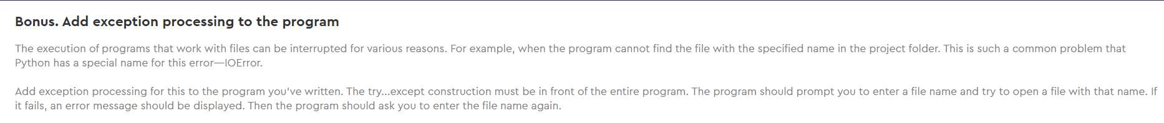
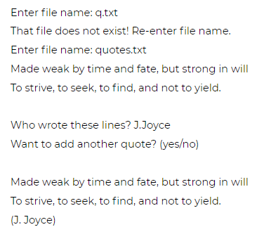
How to solve the bonus task?
Bonus. Exception processing
Working in
VS Code
The result of the program running in the console

Slide 31
How to solve the bonus task?
Bonus. Exception processing
while True:
try:
file = open(filename, "r")
break
except IOError:
The program asks for a file name
The command is trying to open the file with the specified name.
If it fails to open, the function returns a special error — IOError
Working in
VS Code
The program asks to enter the correct name

Slide 32
How to solve the bonus task?
Bonus. Exception processing
while True:
try:
file = open(filename, "r")
break
except IOError:
The program asks for a file name
Some situations (exceptions) in Python have their own names.
For example, the input/output error, IOError ("file not found")
Working in
VS Code
The program asks to enter the correct name

Slide 33
Module 3. Lesson 1. Basics of working with files
New topic:
Optimal
file processing

Slide 34
Reading data line by line
with open("quotes.txt", "r") as file:
for line in file:
print(line)
author = input("Who wrote it? ")
with open("quotes.txt", "a") as file:
file.write("("+author+")"+"\n")
The command to open a file in read mode.
This creates a “File” type object
Brainstorming

Slide 35
Reading data line by line
with open(
"quotes.txt", "r", encoding = "utf-8"
) as file:
for line in file:
print(line)
author = input("Who wrote it? ")
with open(
"quotes.txt", "a", encoding = "utf-8"
) as file:
file.write("("+author+")"+"\n")
The command to open a file in read mode.
This creates a “File” type object
Brainstorming

Slide 36
Reading data line by line
with open(
"quotes.txt", "r", encoding = "utf-8"
) as file:
for line in file:
print(line)
author = input("Who wrote it? ")
with open(
"quotes.txt", "a", encoding = "utf-8"
) as file:
file.write("("+author+")"+"\n")
The for loop makes the file read line by line.
Brainstorming

Slide 37
Reading data line by line
with open(
"quotes.txt", "r", encoding = "utf-8"
) as file:
for line in file:
print(line)
author = input("Who wrote it? ")
with open(
"quotes.txt", "a", encoding = "utf-8"
) as file:
file.write("("+author+")"+"\n")
The for loop makes the file read line by line.
When transferring a parameter of the file type, the loop automatically understands that line-by-line reading needs to be performed.
The file lines are loaded into the line variable.
Brainstorming

Slide 38
Task:
A class performance report file is given (minimum grade is 2, maximum is 5).
We need to display the names of the top students in the console and calculate the average grade for the class.
James S. 4
Johnson M. 4
Smith K. 3
Bodler L. 2
Holmes O. 4
Harold O. 5
Madison P. 3
Brainstorming
pupils.txt

Slide 39
How do we find the names of the top students in the file?
Иванов О. 4
Петров И. 3
Дмитриев Н. 2
Смирнова О. 4
Harold В. 5
Котов Д. 2
Бирюкова Н. 5
Данилов П. 3
Аранских В. 5
Лемонов Ю. 2
Олегова К. 4
James S. 4
Johnson M. 4
Smith K. 3
Bodler L. 2
Holmes O. 4
Harold O. 5
Madison P. 3
Brainstorming
pupils.txt

Slide 40
Possible option:
Open the file for reading information.
Read the information line by line:
1 line for 1 student.
The word before the first space is the last name.
The last character in the line is the grade.
Brainstorming
Harold
space
O.
space
5
line

Slide 41
How do we get from line a substring with the name a substring with the grade?
Brainstorming

Slide 42
Use the split method:
Harold
space
O.
space
5
line
data = line.split(" ")
Brainstorming

Slide 43
Use the split method:
Harold
space
O.
space
5
line
data = line.split(" ")
Brainstorming
data = [
“Harold”
,
“O.”
,
“5\n”
]
data[0]
data[2]

Slide 44
To display the names of the top students, we need to know which grade corresponds to a specific last name.
Brainstorming

Slide 45
How do we link the data on last names and grades?
Jameson L. 4
Holmes S. 3
Davidson M. 2
Waldorf K. 4
Archibald W. 5
Brainstorming
pupils.txt

Slide 46
How do we link the data on last names and grades?
Harold
space
O.
space
5
Brainstorming
Student’s last name
First initial
Grade
The Pupil class

Slide 47
Creating the Pupil class
class Pupil:
'''Stores data about the student
(surname, name, and grade)''
The constructor that sets the values for Name, Surname, and Mark
for an instance of the class.
Brainstorming
When transferring the grade data[2] to the constructor, it must be made an integer:
pupil = Pupil(data[0], data[1], int(data[2]))

Slide 48
Idea:
Read the information about a student
Convert each line of information
into a Pupil type object
Brainstorming
Analyze if they are a top student and save their grade
The next student is read and processed in the same Pupil object.
(no huge lists of pupils)

Slide 49
Note:
To calculate the average class grade and the number of top students, we create:
the sum variable (to add up the grades) and the amount variable (to calculate the number of students);
the best_pupils list (to store the names of the top students).
sum
amount
best_pupils [ ]
1.
Waldorf
4
4
1
-
Brainstorming
Archibald
5
9
2
Add “Archibald”
2.
Holmes
3
12
3
-
3.

Slide 50
Note:
To calculate the average class grade and the number of top students, we create:
the sum variable (to add up the grades) and the amount variable (to calculate the number of students);
the best_pupils list (to store the names of the top students).
Best_pupils = []
with open("pupil_large.txt", "r") as file:
for line in file:
data = line.split(" ")
#creating the “Pupil” object. Now we will work with it
data_pupil = Pupil(data[0], data[1], int(data[2]))
#if the grade is 5, we add the student to the list of top students
if data_pupil.Mark == 5:
Best_pupils.append(data_pupil.Surname)
Brainstorming

Slide 51
Note
Different types of data can be read and separated from each other in different ways:
Determining the type according to the first character of the string (that’s how #hashtags work).
Storing data using predefined structures
(similar to dictionaries where key-value pairs are stored).
Using a combination of multiple data structures (an option for experienced programmers).
Brainstorming

Slide 52
Tasks:
Using Algo VS Code, complete “Files: additional tasks.”
If you have any difficulties, use the level hints.
Brainstorming
Note.
The line “\n” moves the cursor to a new line.
The command print(“Emily\nDickenson”) displays “Emily” on one line and “Dickenson” on another.

Slide 53
Module 3. Lesson 1. Basics of working with files
New topic:
Optimal
file processing

Slide 54
Complete the task in VS Code
Files: additional tasks
Visual Studio Code
Working on
The platform

Slide 55
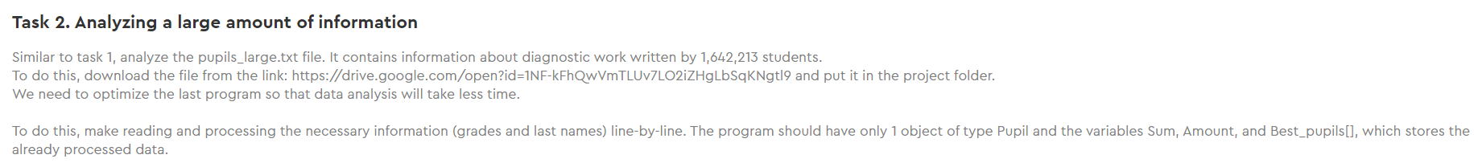
Please note!
Files: additional tasks
Working on
The platform
The big data text file is in Google Drive. You need to download it (copy and open the link in a browser) and upload it to the project folder.

Slide 56

Module 3. Lesson 1. Basics of working with files
End of the
work day

Slide 57


Let’s end the work day by answering these technical questions:
What is a text file? How can a program interact with one?
Which command allows you to open a file for reading? Writing? Appending?
What is the best operator to use for opening and closing a file?
How can you read a file line by line?
Summing up
the work day
Cole,
senior developer
Emily,
project manager

Slide 58

Excellent work!
Colleagues,
Today you learned how to store data for the long-term in separate files.
On our next work day, we will be able to start implementing requests from the science institute!
Summing up
the work day

Slide 59
Additional tasks to improve your performance
Bonus:
Analysis of your group
VS Code
Summing up
the work day

